Slide 1
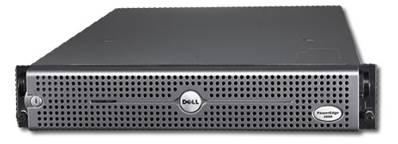
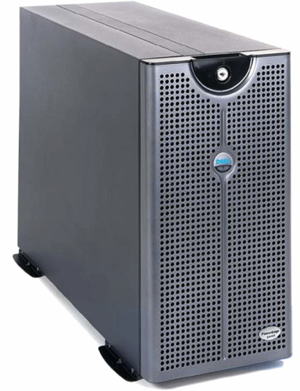
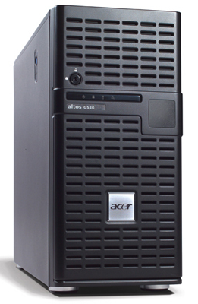
SERVER

Slide 2
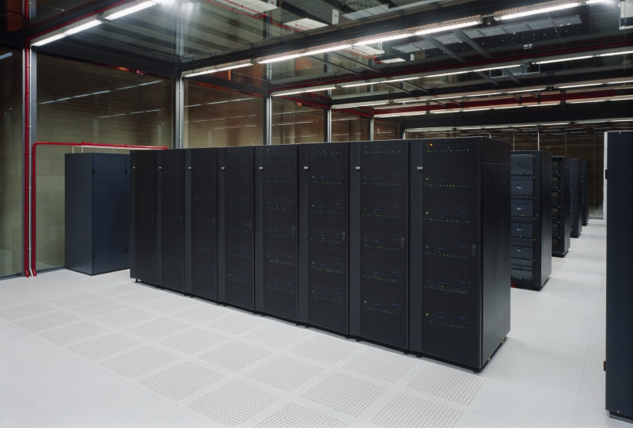
SERVER ROOM

Slide 3
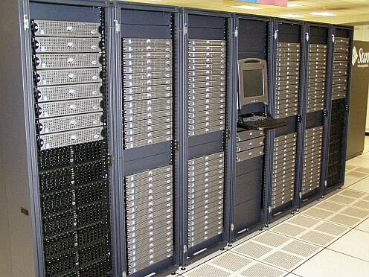
SERVER ROOM

Slide 4
TYPES OF SERVER
A computer that provides access to files for client that are connected to the network
FILE SERVER
PRINT SERVER
A computer that manages printers and print requests from other nodes and network .
EMAIL SERVER
A computer that controls the distribution and storage of e-mail messages
WEB SERVER
A computer that delivers (serves up) web pages .
FTP SERVER

