Slide 1
TOPOLOGY
HUB
terminator

Slide 2
ARCHITECTURE
client request data
HUB
HUB
server
to supply data
peer to peer
client - server

Slide 3

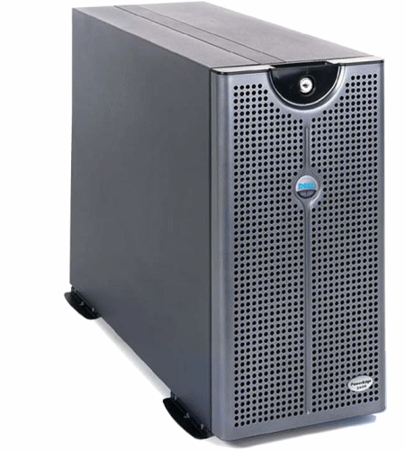
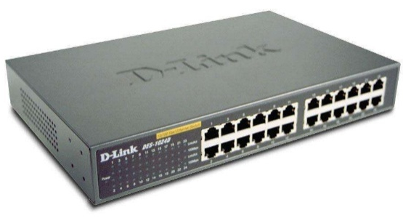

Slide 4
ARCHITECTURE
peer to peer
client - server

Slide 5
ARCHITECTURE
peer to peer
client - server

