Slide 1
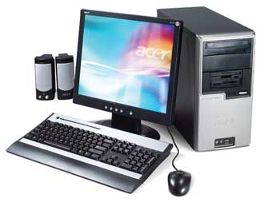
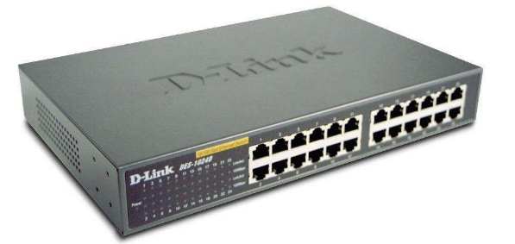
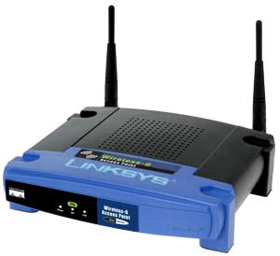
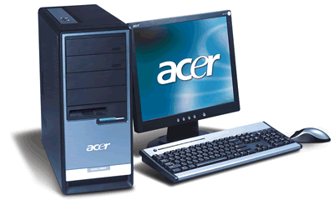
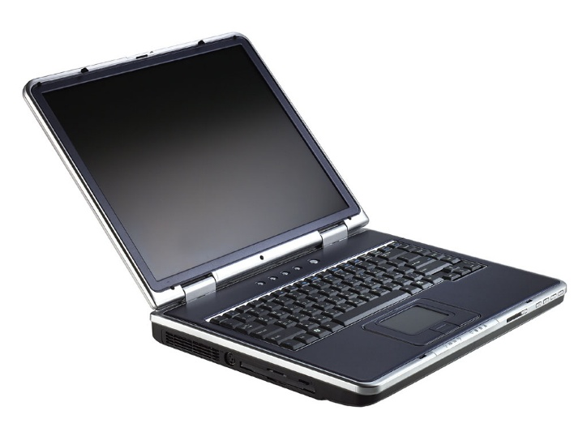
NETWORK

Slide 2
NETWORK
TOPOLOGY
ARCHITECTURE
TYPE OF NETWORKS
TRANSMISSION MEDIA
NETWORK TECHNOLOGIES
COMMUNICATION DEVICES

Slide 3
ARCHITECTURE
TOPOLOGY
TECHNOLOGY
COMMUNICATION
DEVICES
NETWORK
TYPES
PROTOCOL
TRANSMISSION MEDIA
SOFTWARE

Slide 4
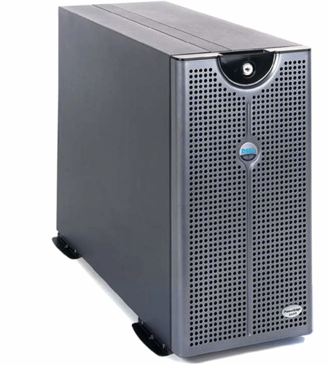
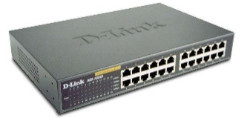
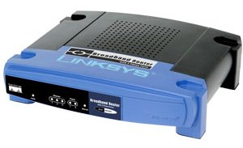
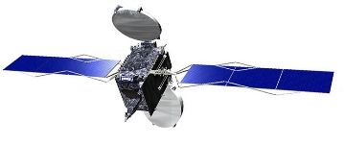

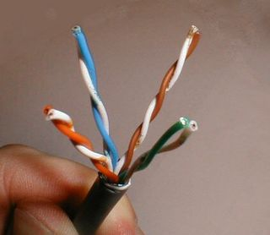
TOPOLOGY
ARCHITECTURE
TYPES
STAR
RING
BUS
PEER TO PEER
CLIENT-SERVER
LAN
MAN
WAN
TECHNOLOGY
DEVICES
NETWORK
INTRANET
EXTRANET
INTERNET
NIC
HUB
ROUTER
MODEM
ACCESS
POINT
PROTOCOL
192.168.1.3
TCP/IP
SOFTWARE
MEDIUM
PYSHICAL / WIRELESS
TWISTED PAIR, COAXIAL, FIBRE OPTIC
INFRARED, RADIOWAVE, SATELLITE
NETWORK OPERATING SYSTEM
CLIENT SOFTWARE

Slide 5

Network
What the advantages of
computer network ?
Standalone

Slide 6
Advantages of Network
Sharing of peripheral devices.
Sharing of program/software.
Sharing of files.
Sharing of data.
Sharing of information.
Sharing of internet connection.
Access to database.
Better communication.

Slide 7
TYPE OF NETWORK
LAN
MAN
WAN

